Slide 1
Red Hat AMQ Streams with Ansible
Chatchai Kongmanee
Specialist Solution Architect
Red Hat, Thailand

Slide 2








Manual Collaborate between teams
Automation and IT modernization
Deploy Database
Need a vm for an Application Deployment
DBA
System Admin
Need more Storage
Software Admin
User
Deploy App
Storage Admin

Slide 3





Automation way
Automation and IT modernization
Need a vm for an Application Deployment
System Admin
Storage Admin
DBA
Software Admin
Automation deployment
Infrastructure as Code
vm
+
Storage
+
+
DB
App
User

Slide 4







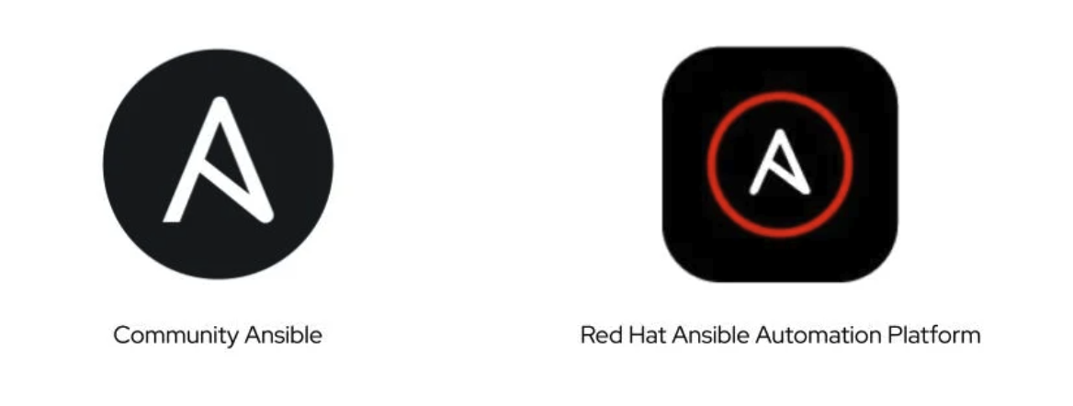


What is Ansible?
Ansible® is an open source, command-line IT automation software application written in Python. It can configure systems, deploy software, and orchestrate advanced workflows to support application deployment, system updates, and more.
Ansible’s main strengths are simplicity and ease of use. It also has a strong focus on security and reliability, featuring minimal moving parts. It uses OpenSSH for transport (with other transports and pull modes as alternatives), and uses a human-readable language that is designed for getting started quickly without a lot of training.
PUBLIC / PRIVATE CLOUD
PUBLIC / PRIVATE CLOUD
CMDB
ANSIBLE AUTOMATION ENGINE
USERS
INVENTORY
CLI
HOSTS
MODULES
PLUGINS
NETWORK DEVICES
ANSIBLE PLAYBOOK

Slide 5


Example AMQ Streams with Ansible
AMQ Streams with Ansible
Example Environment
Required:
OS : RHEL 8
Hostname
Ip address
Username / password (sudoer)
DNS servers
Domain
Internet access for Ansible node
Access to monitor node UI service from customer workstation
Ansible node
9092
broker1
TLS
broker2
zookeeper 1
producer
zookeeper 2
broker3
zookeeper 3
consumer
broker4
node exporter : 9100
kafka_exporter: 9308
kafka / zookeeper : 7075
Internet
Internet
Access
SSH
SSH
FIREWALL
Ansible
SSH
monitor
Install Ansible
Git Repository
SSH
Prometheus : 9090
Grafana : 3000
AlertManager: 9093
Red Hat Remote
Customer Workstation

Slide 6
Installation & Configuration
Installation & Configuration
Automated by Ansible
Example Ansible Playbooks
Install and configure JDK
Install and configure zookeepers and brokers with TLS and SASL authentication enabled
Install and configure Kafka Exporter to monitor OS and Kafka
Install and configure Prometheus & Grafana

Slide 7
AMQ Streams with Ansible
Installation Process Overview
SSL Key generate
(script)
Kafka packages installation
(Ansible)
Hosts file update for internal communication
(Ansible)
Configure Kafka parameter
(Ansible)
SSL keys generated by script
(openssl & jdk keytool)
Day0 , Day1: Tasks Deploy by Ansible
AMQ Streams dependencies installation
AMQ Streams Package installation
Internal Communication prerequisites setup
Day2: Operations
Initial Parameter setup
Configuration change management for broker and zookeeper node

Slide 8



AMQ Stream package installation
AMQ Stream package installation
Inventory file
/etc/hosts
Add host record for all broker and zookeeper node
Passwordless
SSH
execute
Ansible
Broker and zookeeper
Install Java JDK 11
Install java jdk from local rpm
Remove older version if installed
copy
/kafka_tmp
Extract
/kafka
/kafka/bin
Contain kafka binary files
/kafka/config
Contain kafka Configuration files
/kafka/libs
Contain kafka Library files

Slide 9

AMQ Stream package installation
AMQ Streams : Broker configuration
execute
Ansible
SSH
Broker
truststore.jks
Use for authentication
create
copy
copy
/kafka/keys
keystore.jks
Use for identification
Regular : unique for each host
Wildcard : single file for matched suffix
create
/kafka/config
copy
Inventory file
Server-jaas.properties
Authentication information
Copy & modified
create
server.properties
Set broker ID
Set listener IP
Set Advertised IP
Set zookeeper.connect parameter
Set authentication
/kafka_data/kafka
store data stream from application
Set log.dir
create
/kafka_log
Set Environment
“LOG_DIR”
copy
Set ExecStart option ref
Set Environment
“KAFKA_OPTS”
Copy & modified
/etc/systemd/service
kafka.service
systemctl start

Slide 10
AMQ Stream package installation
AMQ Streams : Zookeeper configuration
truststore.jks
Use for authentication
SSH
copy
execute
Ansible
Zookeeper
copy
keystore.jks
Use for identification
Regular : unique for each host
Wildcard : single file for matched suffix
create
create
/kafka/keys
copy
zookeeper-jaas.properties
Authentication parameter
/kafka/config
Copy & update record
Inventory file
zookeeper.properties.dynamic
Dynamic zookeeper cluster parameter
Copy & modified
dynamicConfigFile
create
zookeeper.properties
Set broker ID
Set listener IP
Set Advertised IP
Set zookeeper.connect parameter
Set authentication
/kafka_data/zookeeper
Touch file naming with zookeeper id
Set dataDir
create
/kafka_log
Set Environment
“LOG_DIR”
copy
Set ExecStart option ref
Set Environment
“KAFKA_OPTS”
Copy & modified
/etc/systemd/service
zookeeper.service
systemctl start

Slide 11
AMQ Stream package installation
AMQ Streams : POC Monitor node installation
Inventory file
Passwordless
SSH
execute
Ansible
Monitor node
Copy package file
prometheus
http://<<monitor node IP>>:9090
alertmanager
http://<<monitor node IP>>:9093
grafana
http://<<monitor node IP>>:3000
kafka_exporter
http://<<monitor node IP>>:9308/metrics

Slide 12
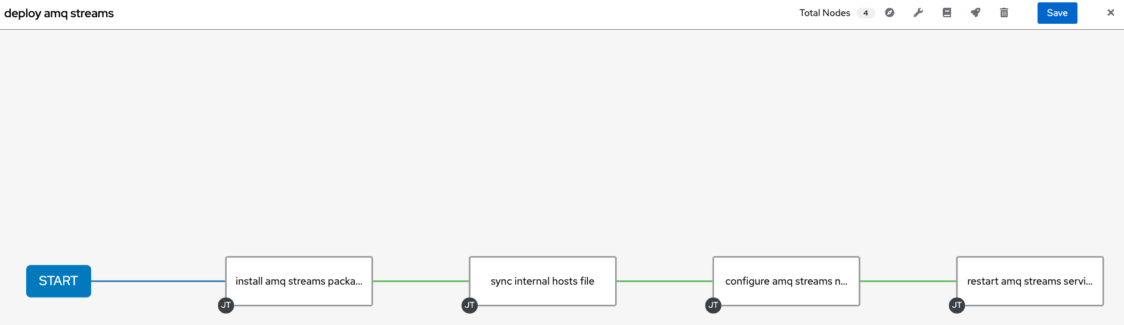
AMQ Stream package installation
Future Automation development : Configuration workflow with Ansible controller

Slide 13
Thank you

